Slide 1
Task 4 – Dashboard Design
.

Slide 2
Objective
Objective:
Understand key sales trends and insights from book data.
Tools Used:
- Power BI
- Dataset: Book Data

Slide 3
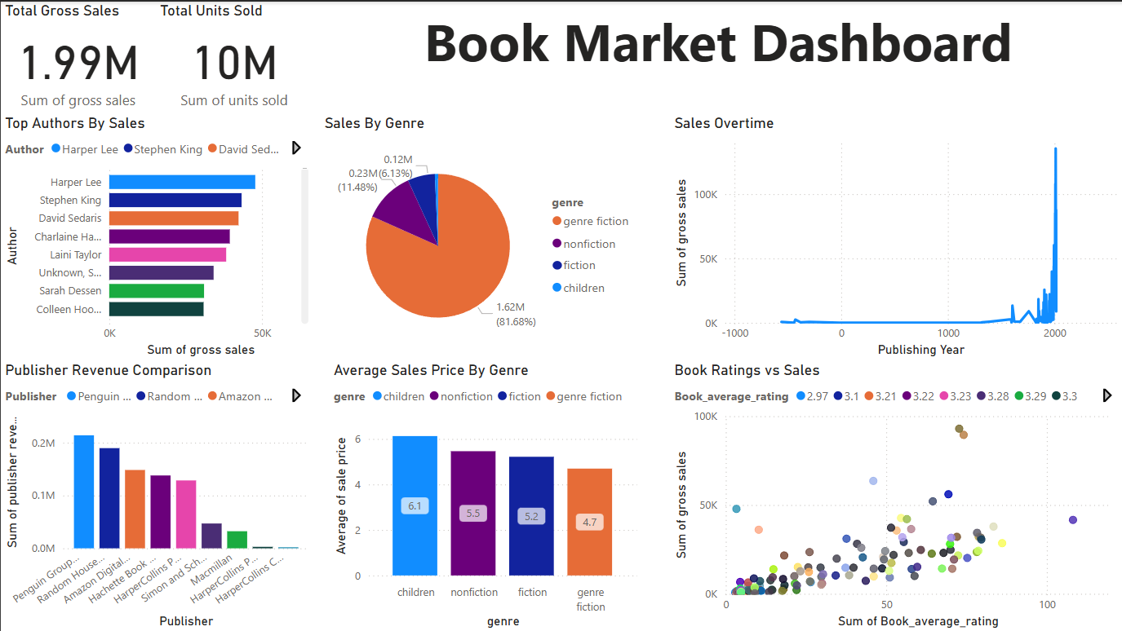
Dashboard Screenshot
Insert Dashboard Screenshot Here

Slide 4
Key Insights
Fiction genre led in sales.
Highest revenue from Penguin Group.
Highly rated books tend to sell more.

Slide 5
Conclusion
Publishers should focus on fiction and highly rated authors.
Data helps target genres and time periods better.
Interactive dashboards empower business decisions.

